Slide 1
Chapter 11 Outline
Network topology
Basic internet structure and routing
Internet host addressing
Network inspection tools

Slide 2
Packet Types
Broadcast
Unicast
Multicast

Slide 3
LAN
Broadcast domain
Physical (behind single router port)
Virtual (VLAN)
Separate switch ports
Virtual router ports

Slide 4
Combining Computer Networks
Many early networks were Wide Area Networks or WANs
As LANs evolved, users wanted to connect LANs to WANs
Some connections had to span two or more WANs to reach from the desired source to the desired destination

Slide 5
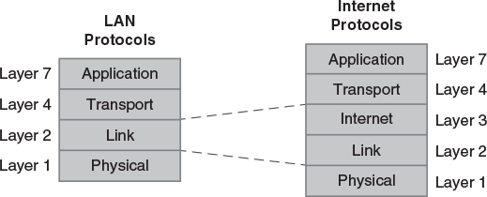
Internet Protocol Stack

Slide 6
Routing Packets Between Networks
A node can move packets between LANs and/or WANs if it has a separate connection and MAC address on each network.
Every host connection also has a separate, unique Internet Protocol address (IP address)
Internet routing nodes (routers) use the IP address to direct the packet to its destination if on different network.

Slide 7
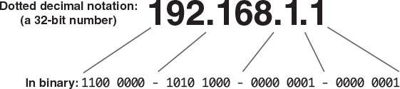
IPv4 Address Format
Four Octets (eight bits, 2^8 power)
Dot decimal notation

Slide 8
Early Internet Security
The Internet evolved from the ARPANET
A research network developed by US DOD
Relied on physical security, a restricted user community, and limited applications for security
As the community grew, security relied on host based authentication (passwords)
Internet Worm and Wily Hacker promoted the development of Internet firewalls
Filtered traffic to try to block attacks

Slide 9
Computing versus Telecom Networks
Computing
Telecom
Internet protocol suite (TCP/IP) is the prevailing standard
Designed around packets
Focus on reliable data transmission between computers
SS7 – Signalling System 7 – is the prevailing standard
Designed around circuits
Focus on telephone and cell phone voice service

Slide 10
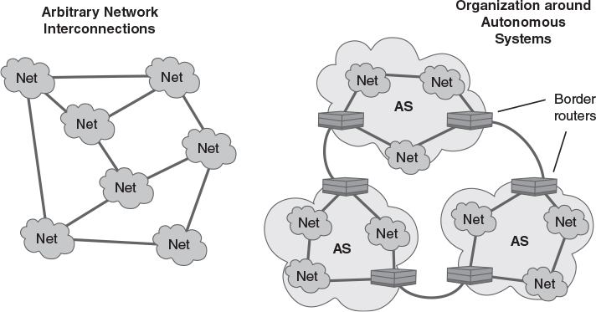
Evolution of Internet Structure

Slide 11
Connections Between Hosts
Socket interface – a popular network API
Provides basic send/receive functions
Basic client/server functions
Listen() – server awaits a connection
Accept() – server accepts a connection
Connect() – client requests a connection
Socket addresses – describe a process-to-process connection across the network

Slide 12
Socket Address Format
Contains pair of IP addresses and port numbers
Port number selects a client or server process
Sender Information
Source port number – chosen randomly by client
Source host's IP address
Recipient information
Destination port number – preassigned for well known Internet services
Destination host's IP address

Slide 13
Examples: Well-Known Port Numbers
21 – FTP
22 – SSH
23 - Telnet
25 – SMTP
53 – DNS
80/443 – HTTP/S
389 – LDAP (AD)
3389 – Remote Desktop

Slide 14
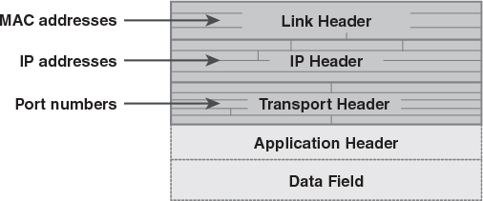
IP Packet Addressing

Slide 15
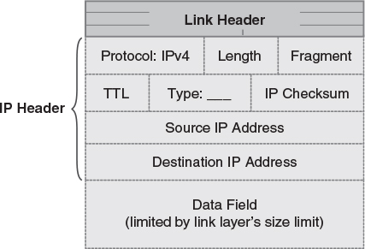
IP Packet Format

Slide 16
Address Resolution Protocol
“ARP” – looks up MAC or IP addresses on a LAN by asking other hosts for answers
Uses Ethernet “broadcast” feature
Asks “Who is 12.34.56.77?” for example
The hosts with answers send responses
Hosts save answers in their ARP cache
“arp” keyboard command prints the cache

Slide 17
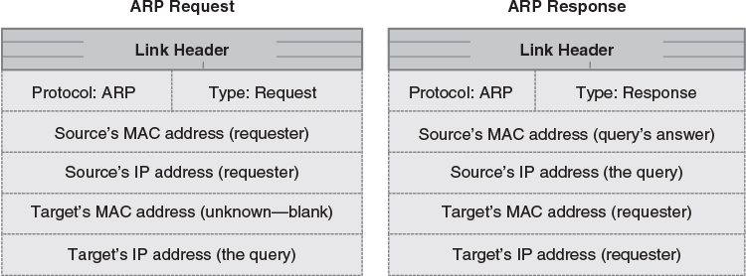
ARP Packet Format

Slide 18
Routing and Addresses
Routing between hosts on a network may rely entirely on ARP
Connections depend on host addresses
To send packets to other networks, routers look at the network address within an IP address
The upper set of bits in the IP address represent the network address
The network mask indicates which bits are network address bits

Slide 19
Logical Subnets/LANs
Logical grouping of systems
Shared network portion of IP address
/8 (CIDR) or 255.0.0.0 (Subnet mask)
/16 or 255.255.0.0
/24 or 255.255.255.0
Broadcast domain
Network address (i.e. 17.0.0.0/8)
Broadcast address (i.e. 17.255.255.255)
Router (gateway) required to send to other subnets – generally first address of subnet

Slide 20
Internet Addresses in Practice
Dynamic/Static addresses
Private addressing
10.0.0.0 - 10.255.255.255
172.16.0.0 - 172.31.255.255
192.168.0.0 - 192.168.255.255
Only work on the internal network
Must be converted to a public address to talk to Internet hosts on other networks
Use Network Address Translation (NAT)

Slide 21
Internet Addresses in Practice
Traditional IPv4 addresses are 32 bits long
Accommodate a few billion hosts
Public addresses are scarce
IPv6
128 bits
Not natively compatible with IPv4
Faster (re-engineered packets)
Security built-in

Slide 22
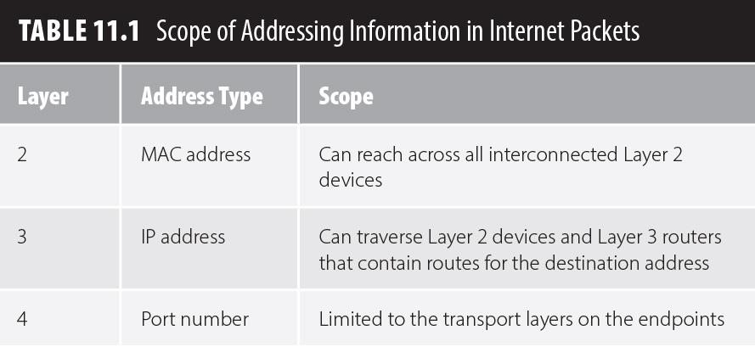
Addressing and Scope

Slide 23
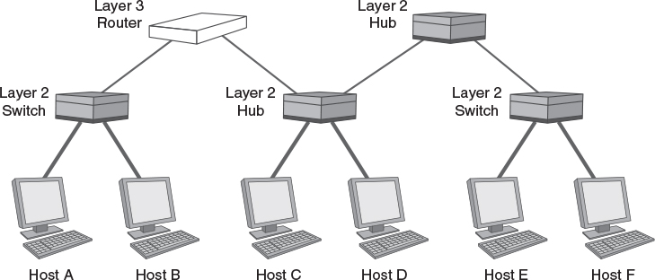
Addressing Scope Example

Slide 24
Network Inspection Tools
Wireshark
Can monitor network traffic in real time
Interprets frame and packet contents
Recognizes standard Internet protocols
Network gateway – lists devices on the LAN
nmap
Can “map” a network
Scans the network address range to locate hosts and the open ports on each host
Caution: May violate an ISP's use policy

Slide 25
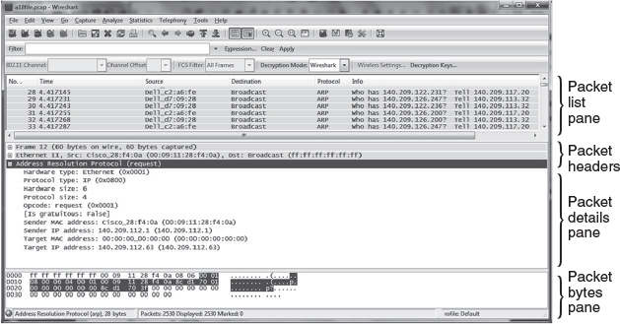
Wireshark Main Window
© Wireshark Foundation

Slide 26
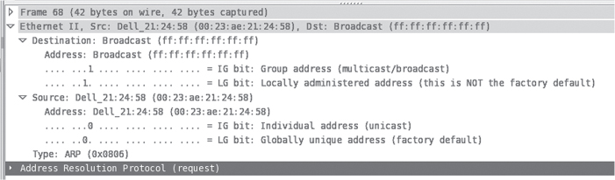
Wireshark: Ethernet Header
© Wireshark Foundation

Slide 27
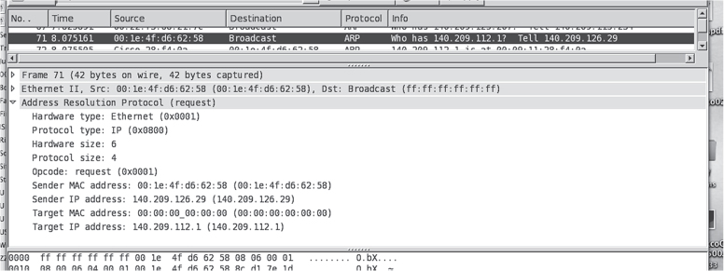
Wireshark: ARP Request
© Wireshark Foundation

Slide 28
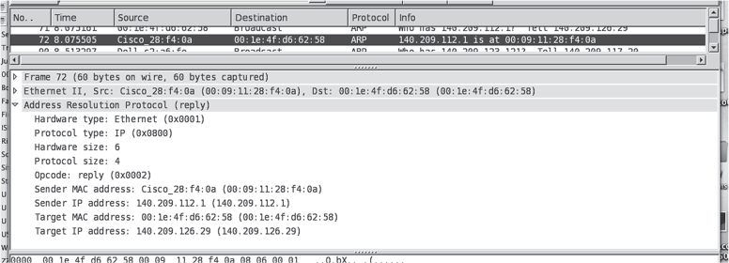
Wireshark: ARP Response
© Wireshark Foundation

Slide 29
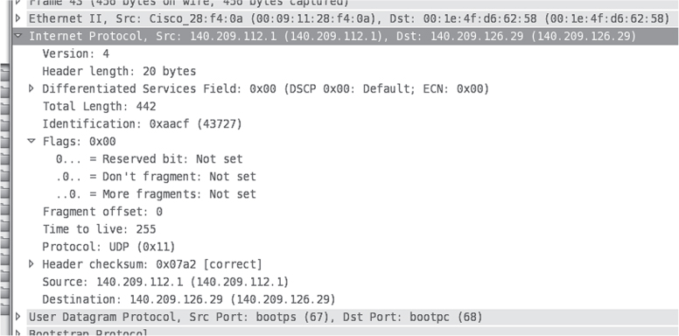
Wireshark: IP Header
© Wireshark Foundation

Slide 30
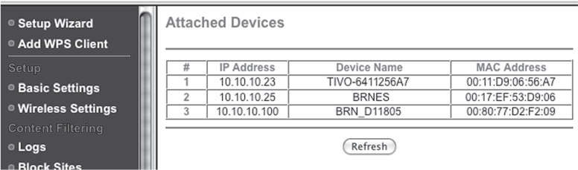
Gateway List of Attached Devices
© Netgear

Slide 31
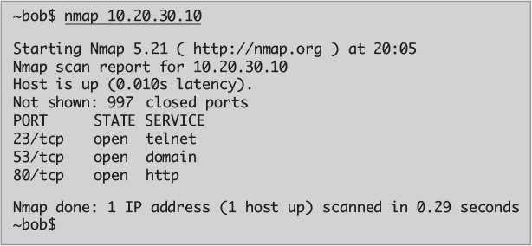
nmap: Scan A Host’s Services

